Slide 1
BCCA figures
Feb 18 2025

Slide 2
At least 5 entries – top – to get stats on % of entries or papers on these:

Slide 3
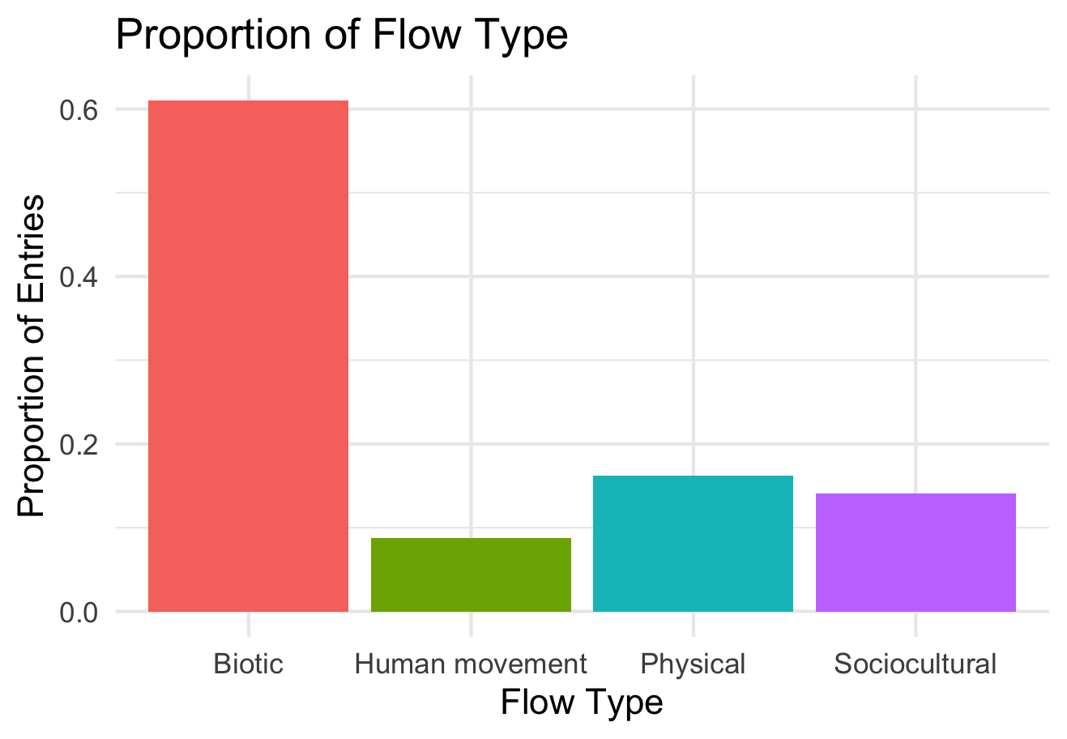

Slide 4
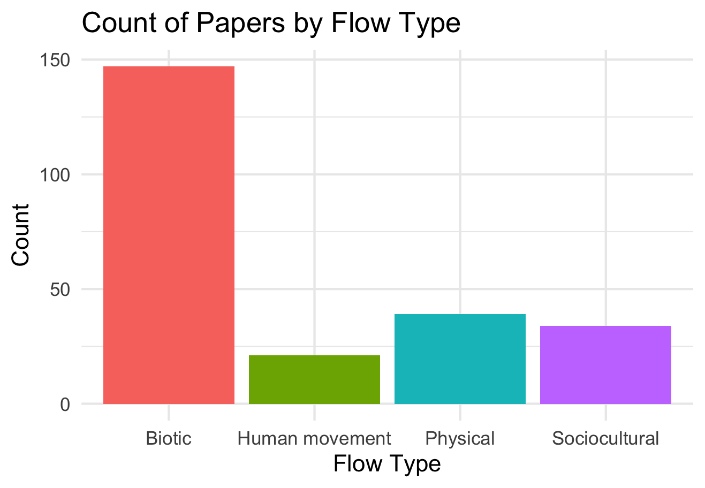

Slide 5
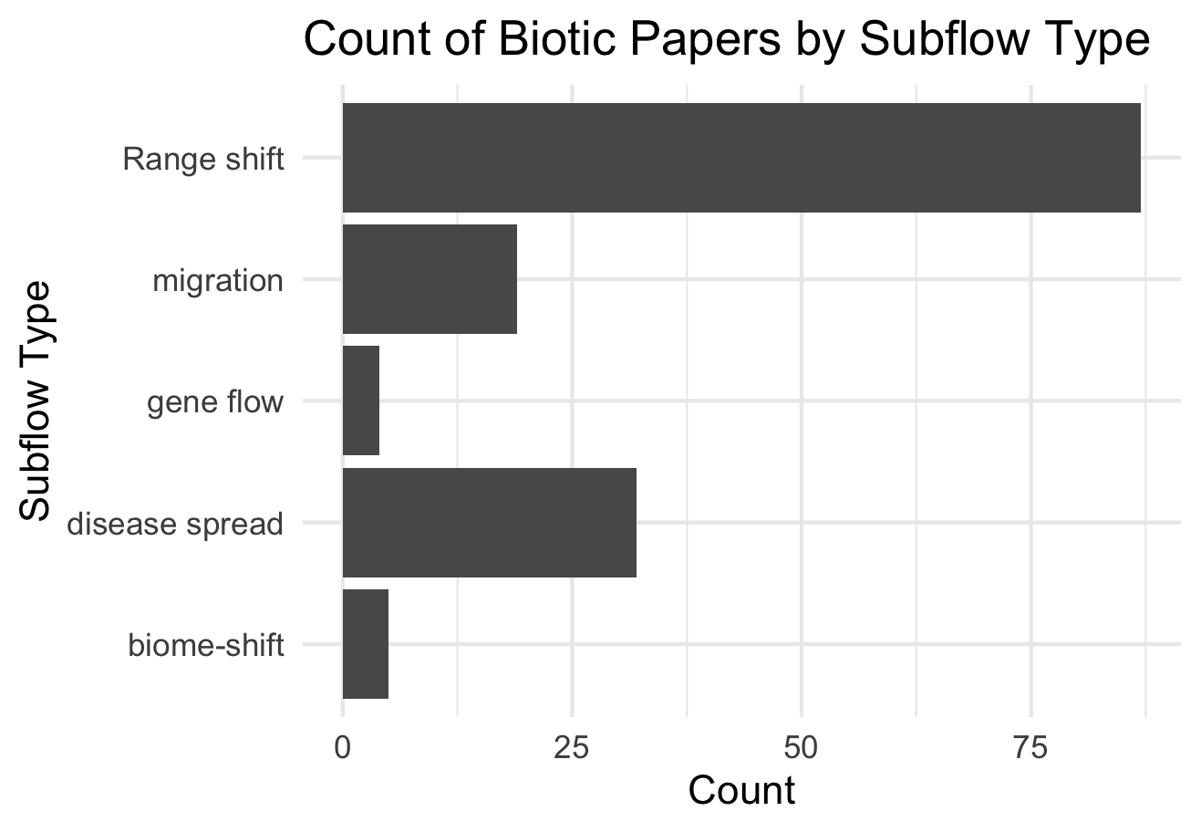

Slide 6
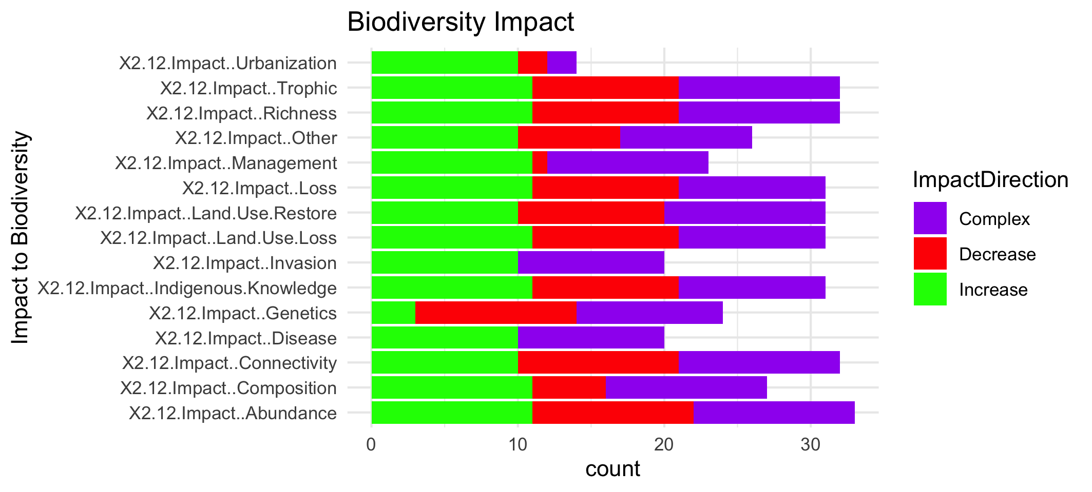

Slide 8
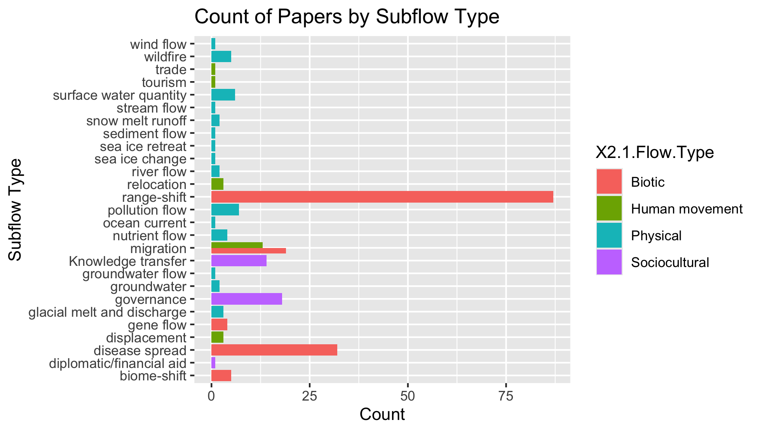
To group physical flow papers

Slide 9
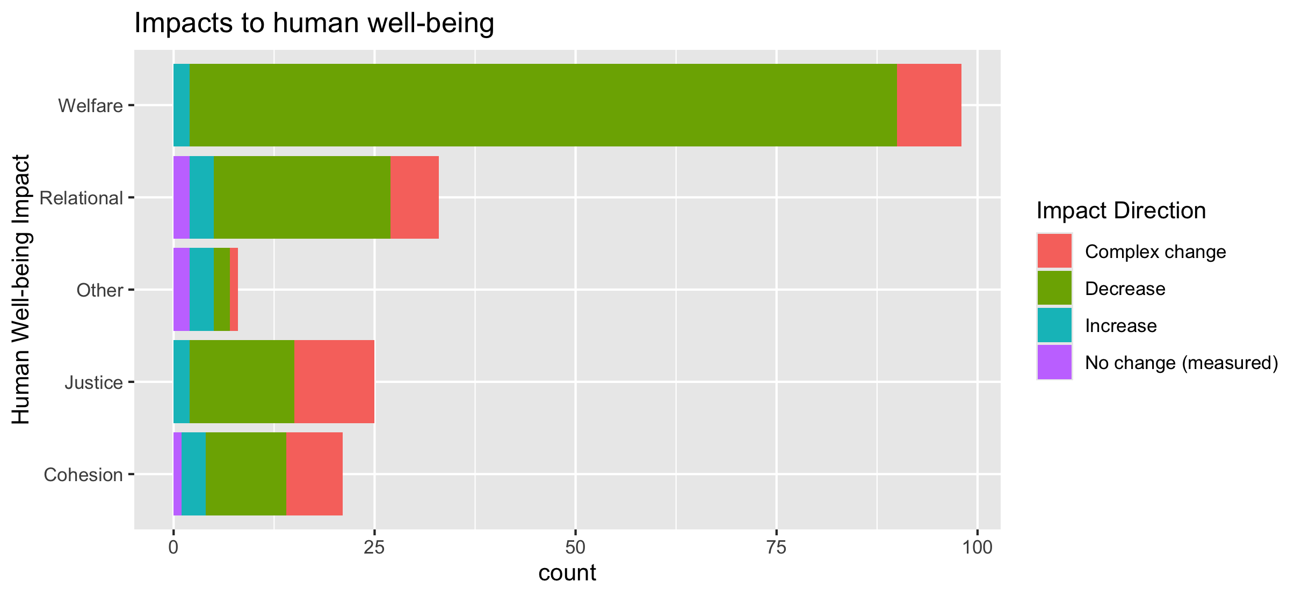
To align direction colors with final color pallet

Slide 10
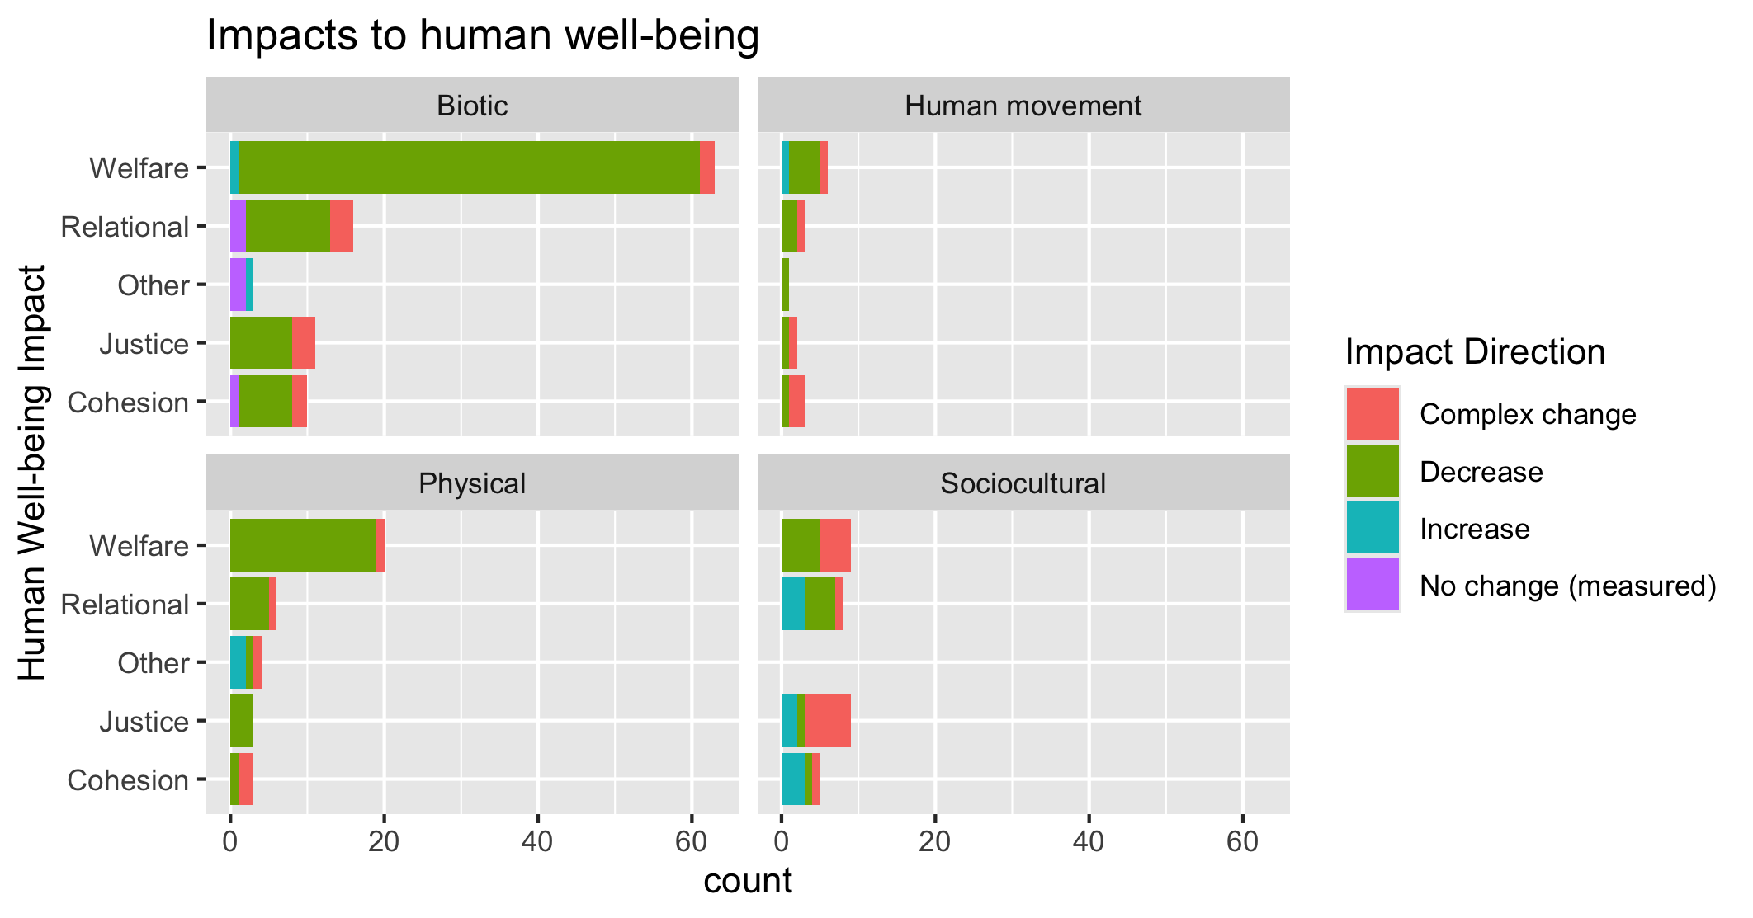
To align direction colors with final color pallet

Slide 11
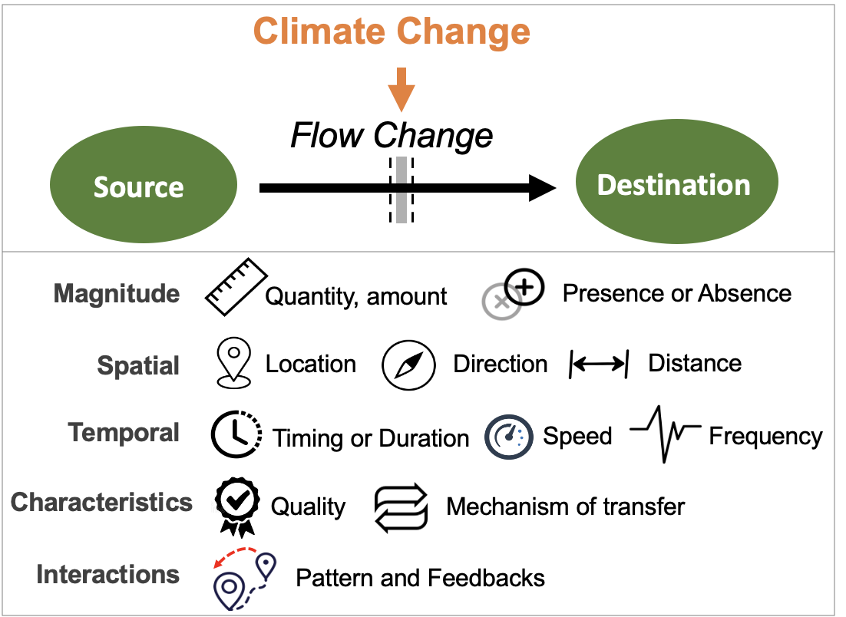
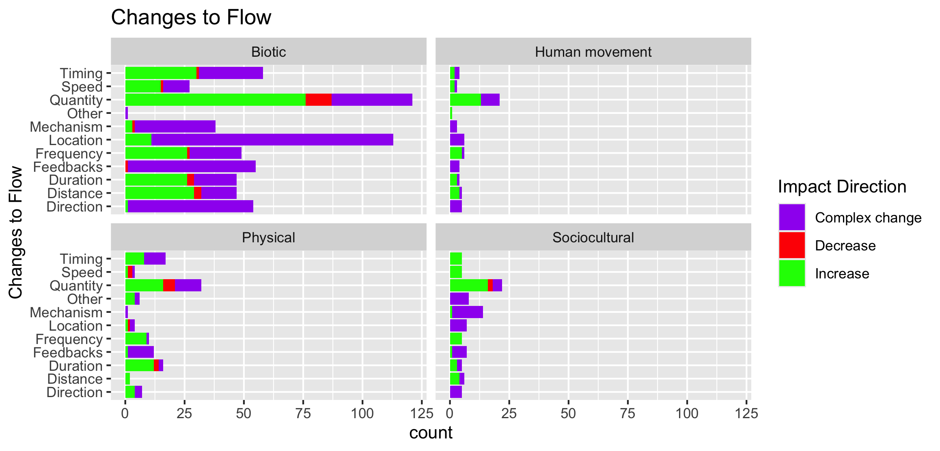

Slide 12
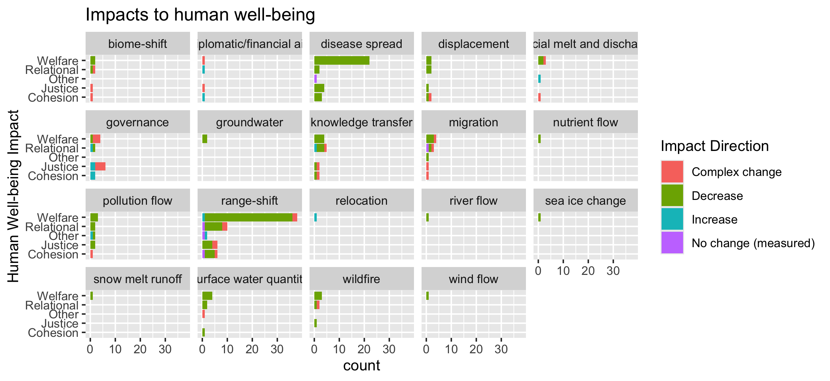
To group physical flow papers

Slide 13
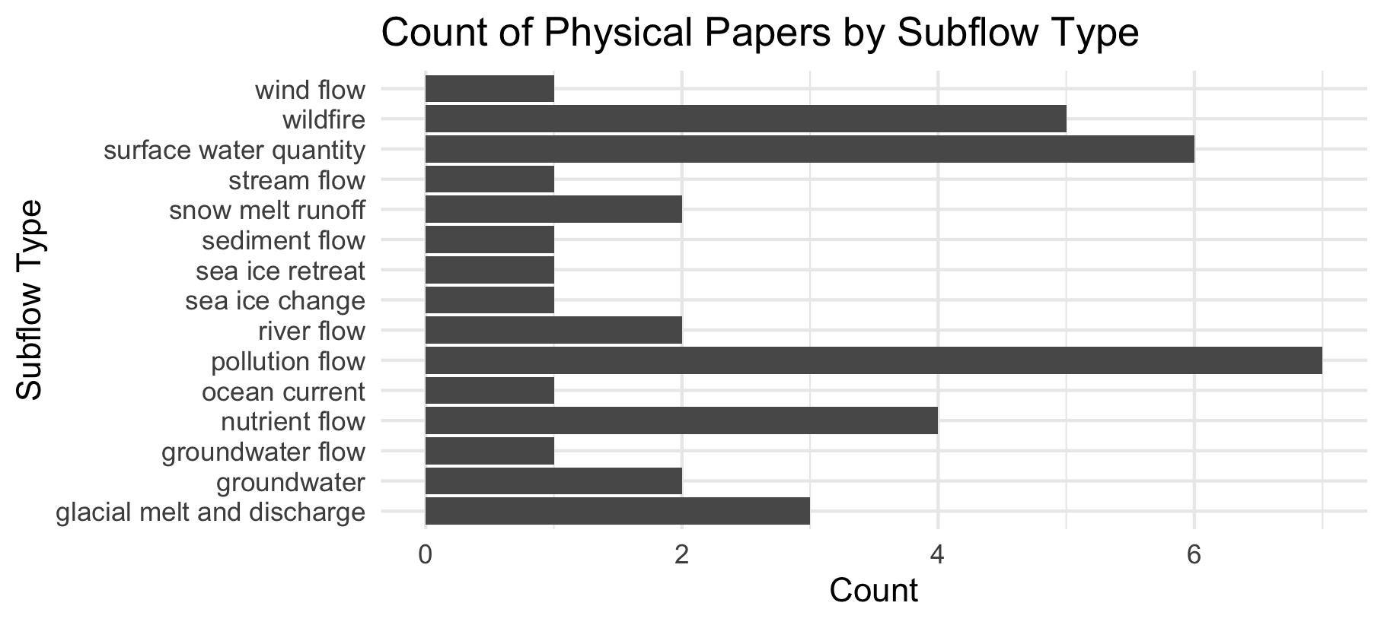

Slide 14
Feb 23 2025

Slide 15
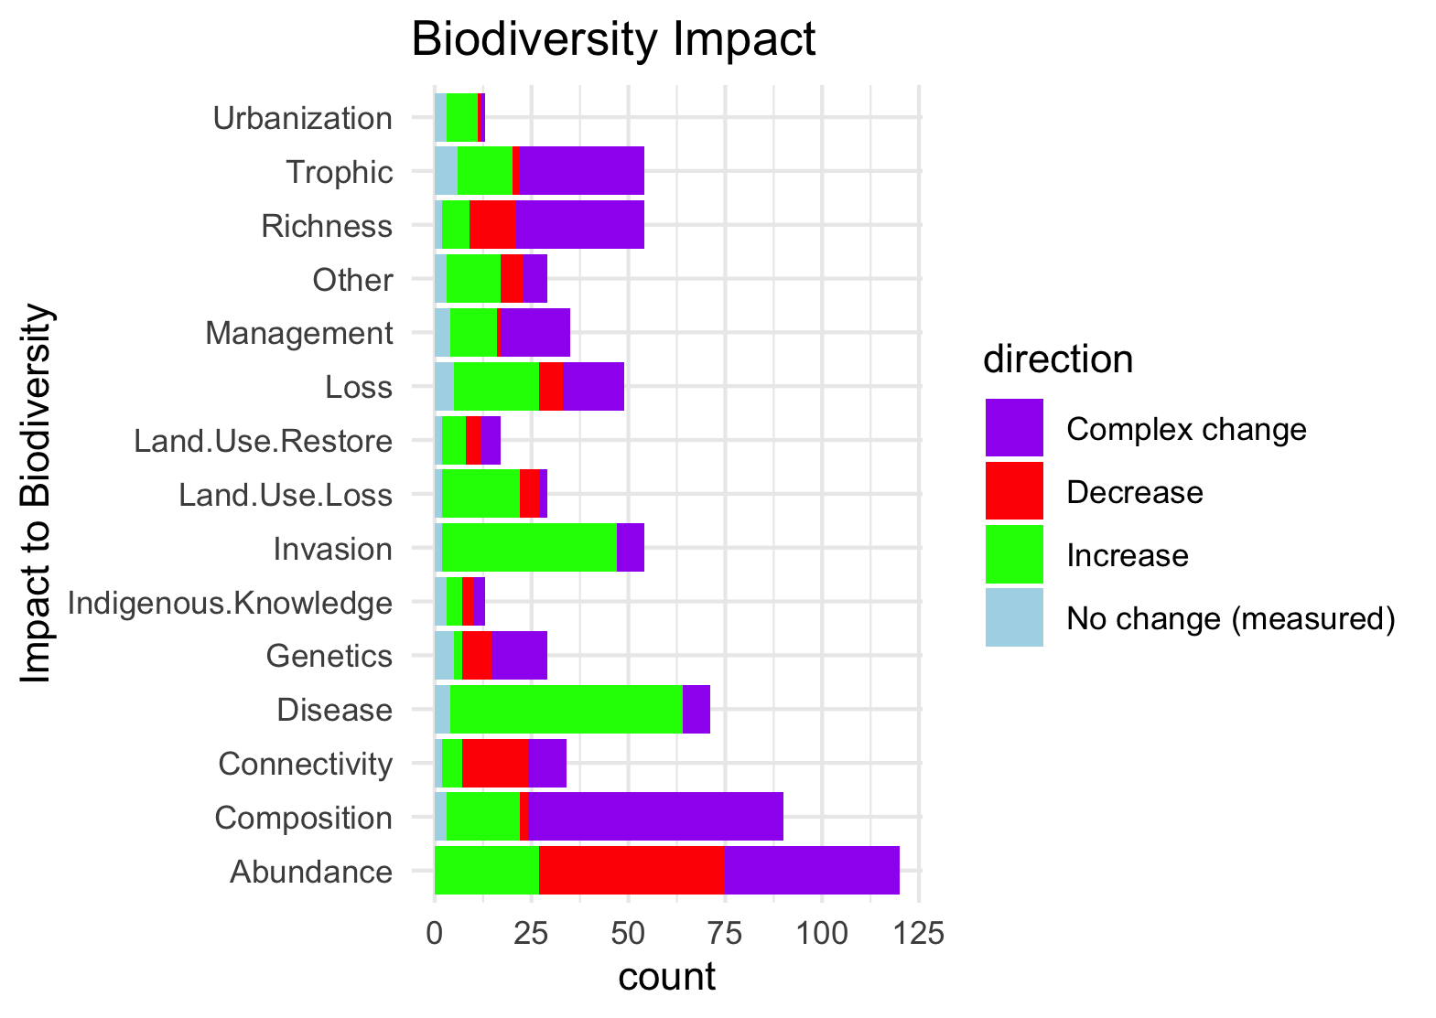
Needs to be grouped by what is good and what is bad to see increase in:

Slide 16
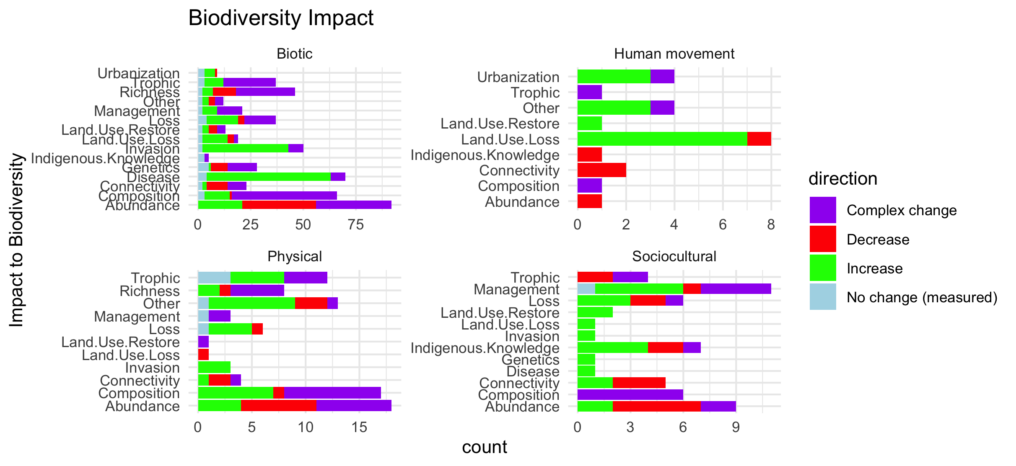
Scale free on the facet (diff x axis)

Slide 17
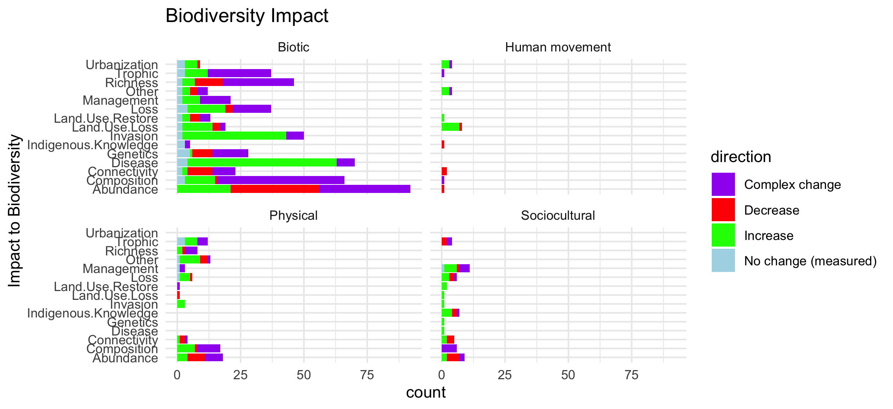
Scale fixed on the facet (same x axis)

Slide 18
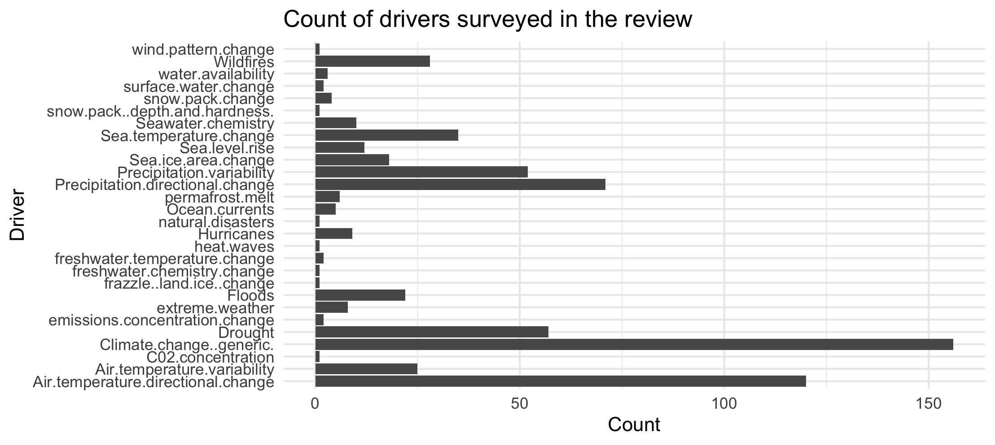

Slide 19
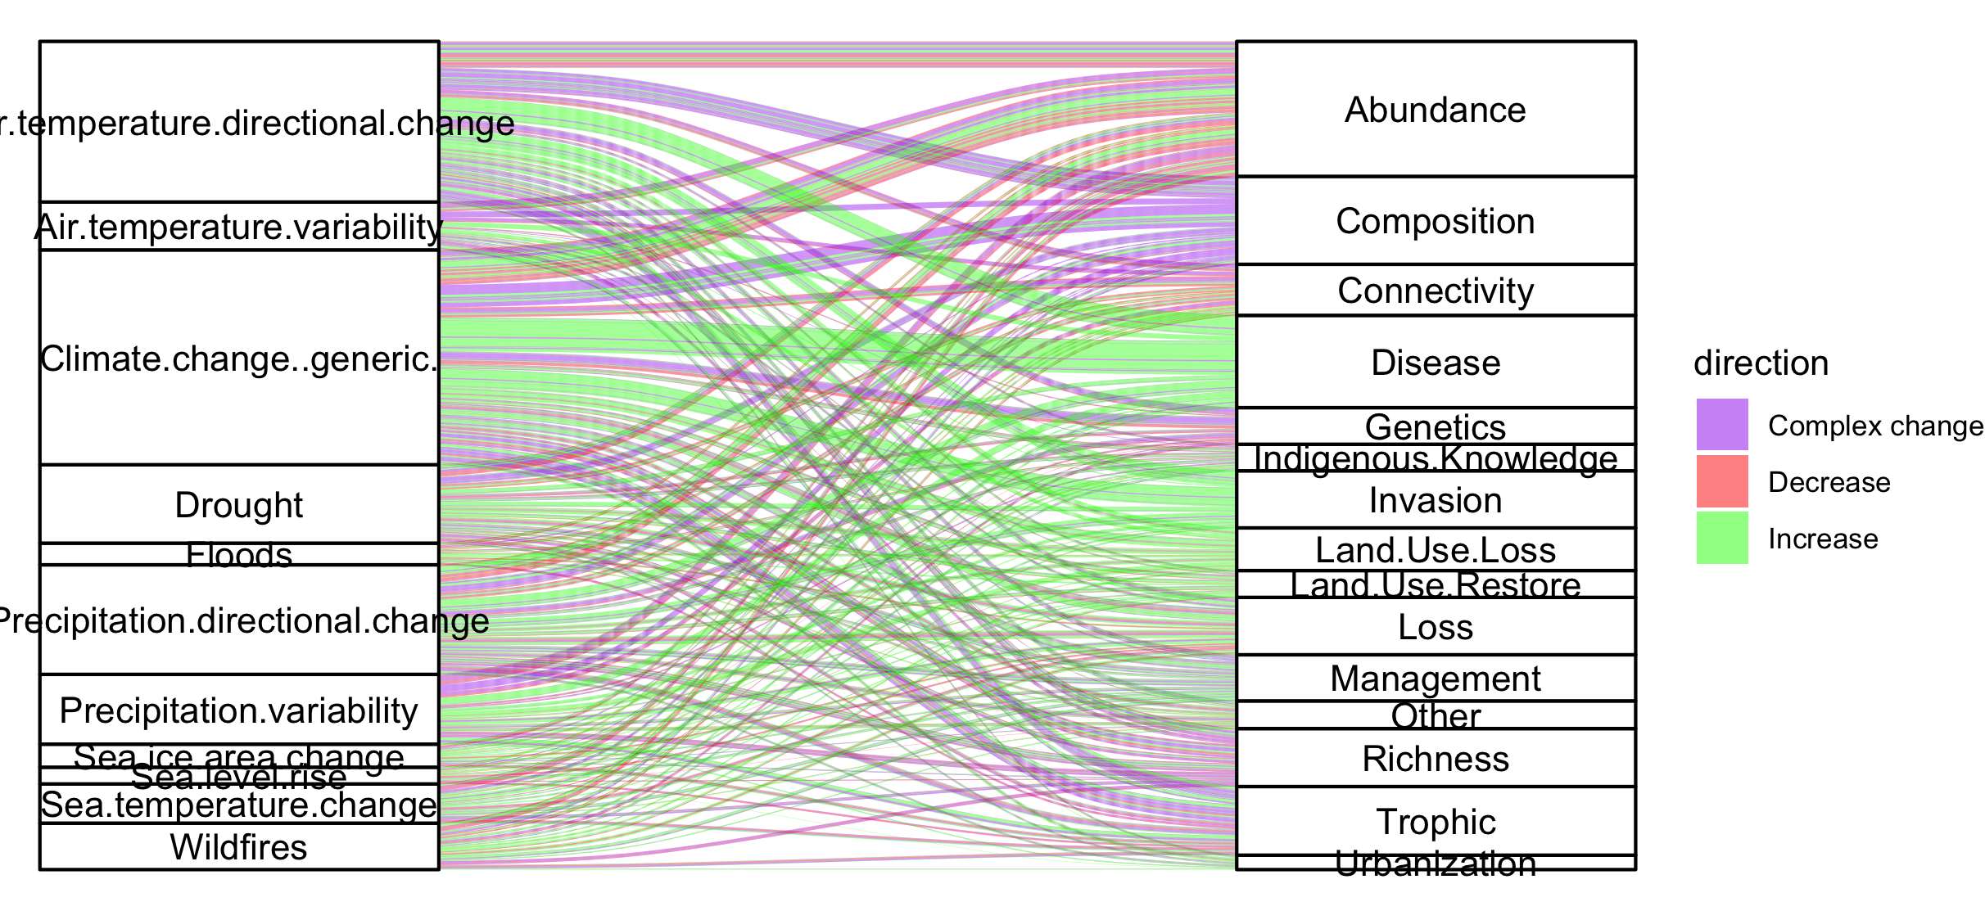
Colleen: see note isn the code – we could group spme of the drivers (hurricaines, extreme weather, ands ome of the ice ones). This still doesnt take into account if changes arw good or bad though and might just be too busy.

Slide 20
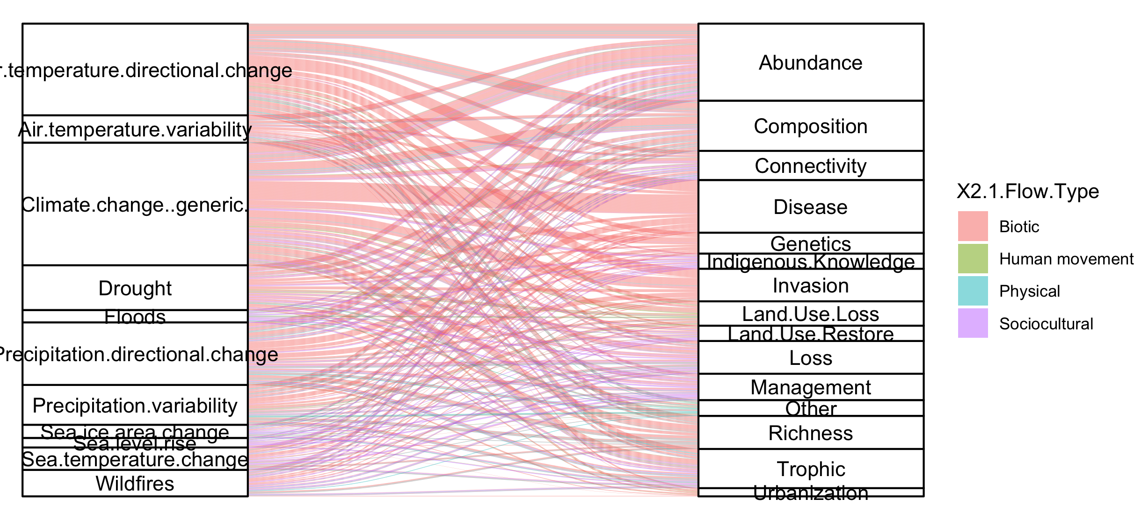
#not that informative because so many more of the papers are biotic

Slide 21
NCPs

Slide 22
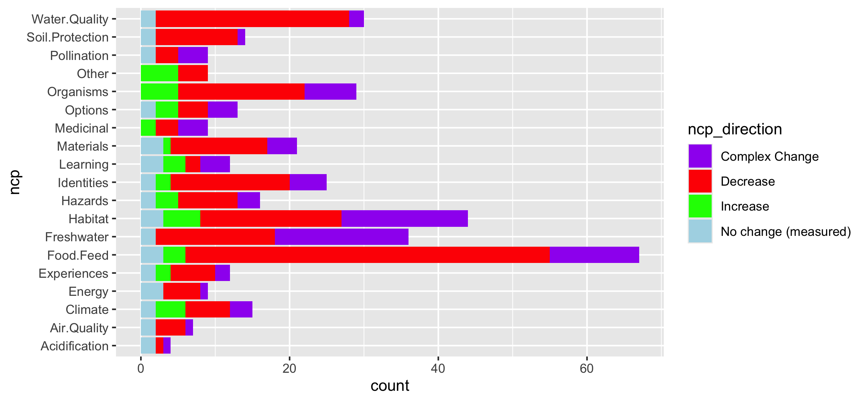
Fix labels

Slide 23
Do by flow type

Slide 24
Fix labels

Slide 25
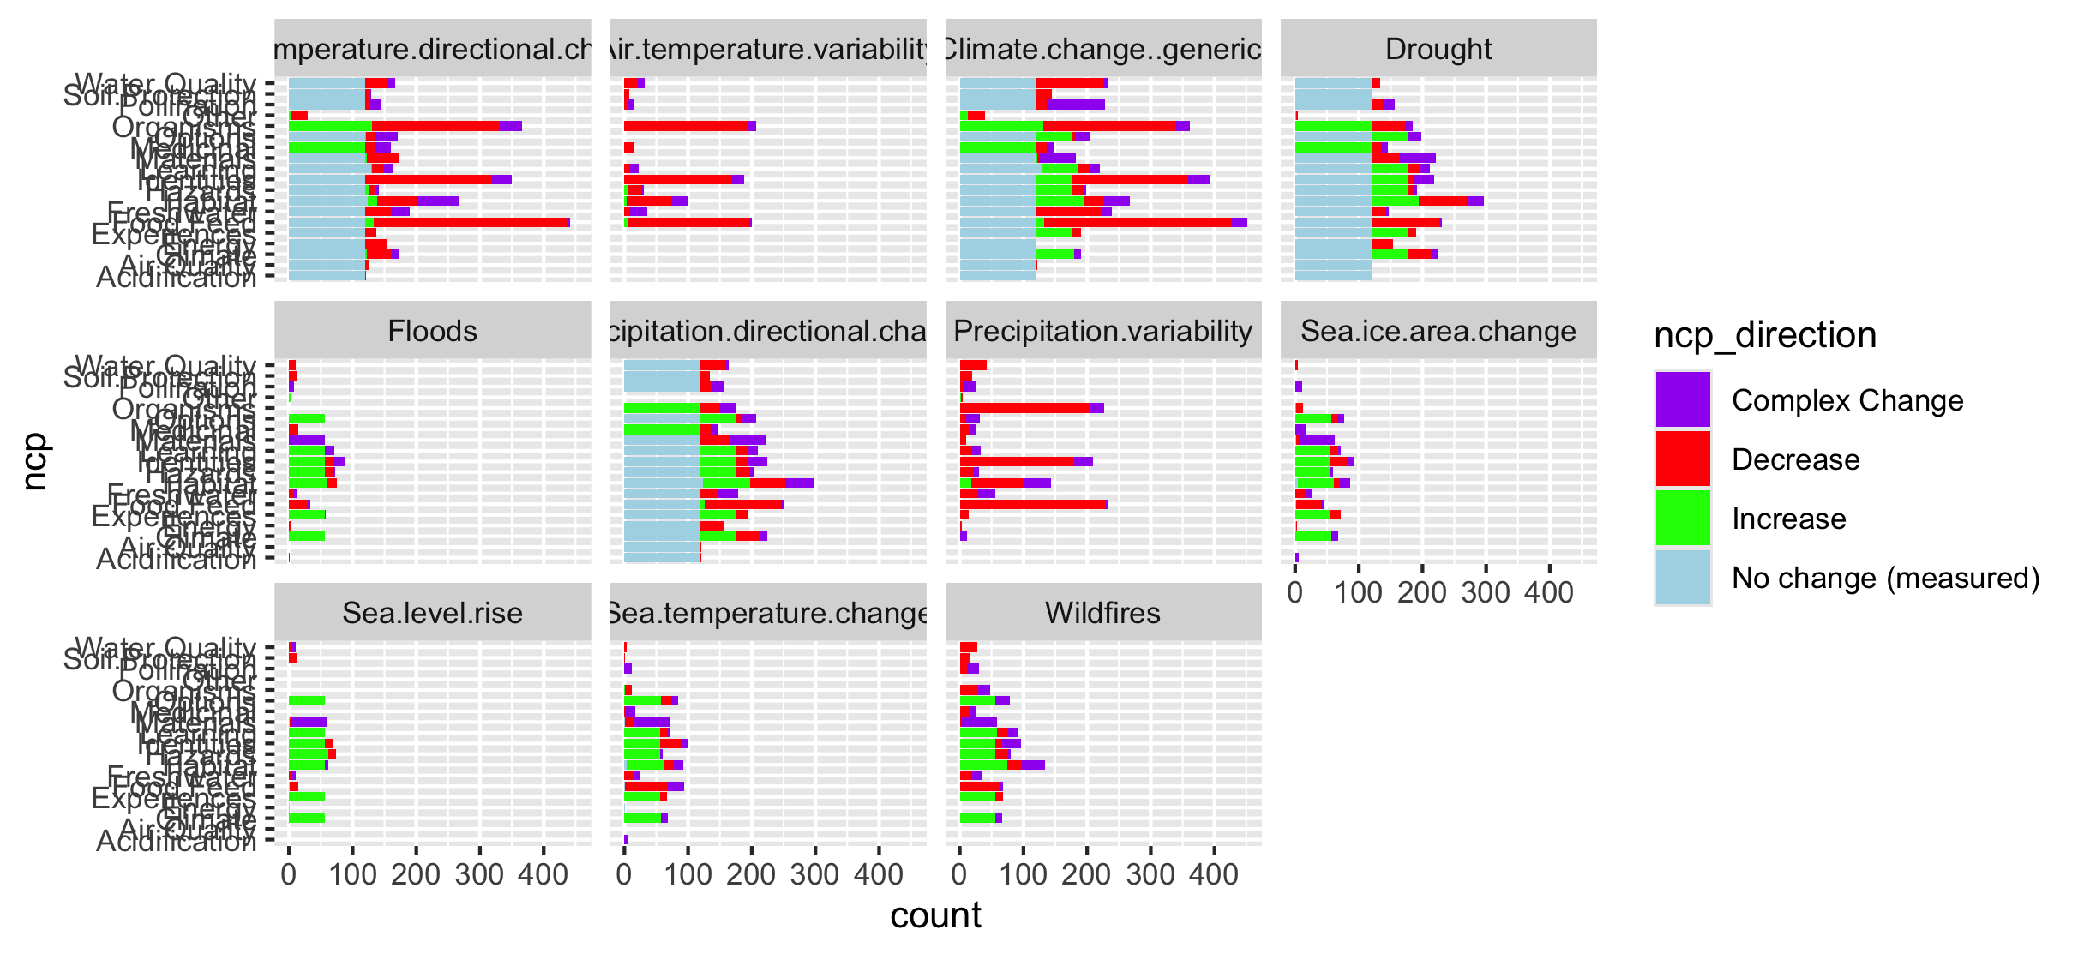

Slide 26
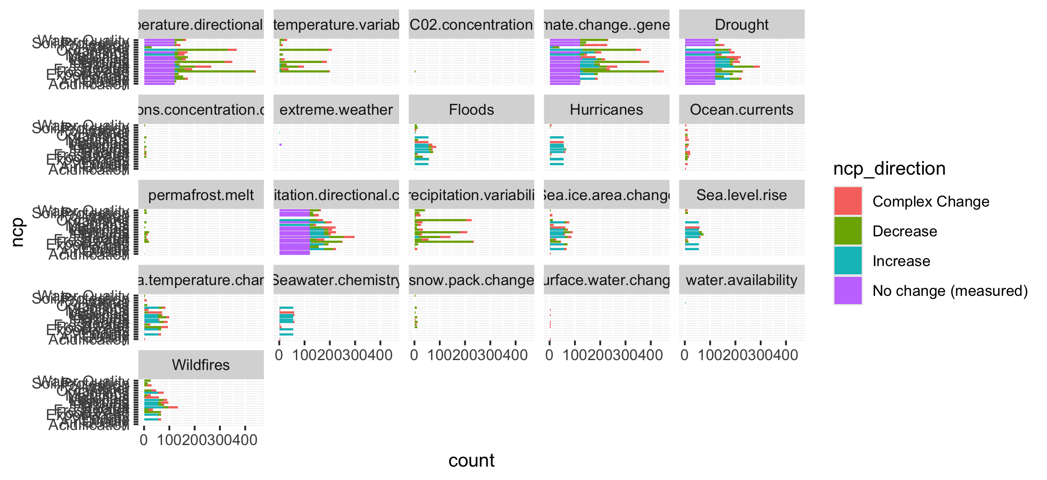
Too many drivers

Slide 27
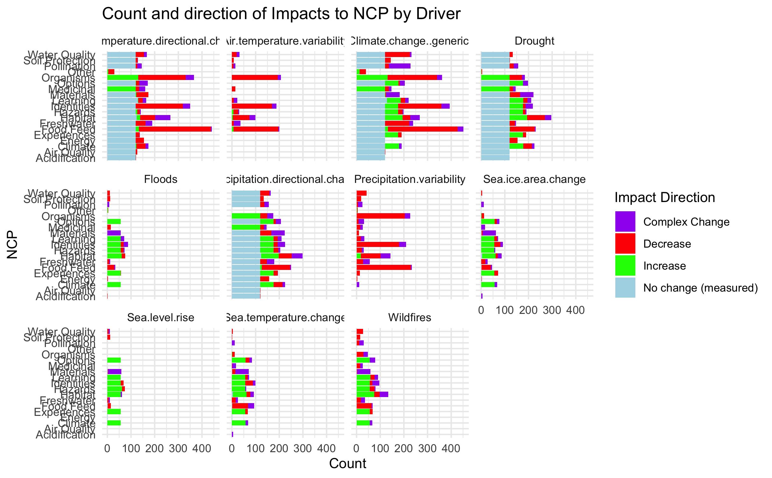

Slide 28
HWB

Slide 29
Connections – how does altered flow relate
Driver~ altered flow (by flow, and subflow – grouped out by flow
Altered flow~ impact (for each category)

